Slide 1
Project – Mini Jira

Slide 2
Project Idea
Task Management Web Service
Simple, scalable, role-based system
Designed for teams & project collaboration

Slide 3
Project Idea
Task Management Web Service
Simple, scalable, role-based system
Designed for teams & project collaboration

Slide 4
Use Cases: Task Management
Create and delete tasks
Asign tasks to team members
Update :
Status (To Do / In Progress / Done … )
Priority ( Low / Medium / High )
Add labels / epics for categorization

Slide 5
Use Cases: Project Management
Create and delete tasks
Asign tasks to team members
Update :
Status (To Do / In Progress / Done … )
Priority ( Low / Medium / High )
Add labels / epics for categorization

Slide 6
Actors
Task Management Web Service
Simple, scalable, role-based system
Designed for teams & project collaboration

Slide 7
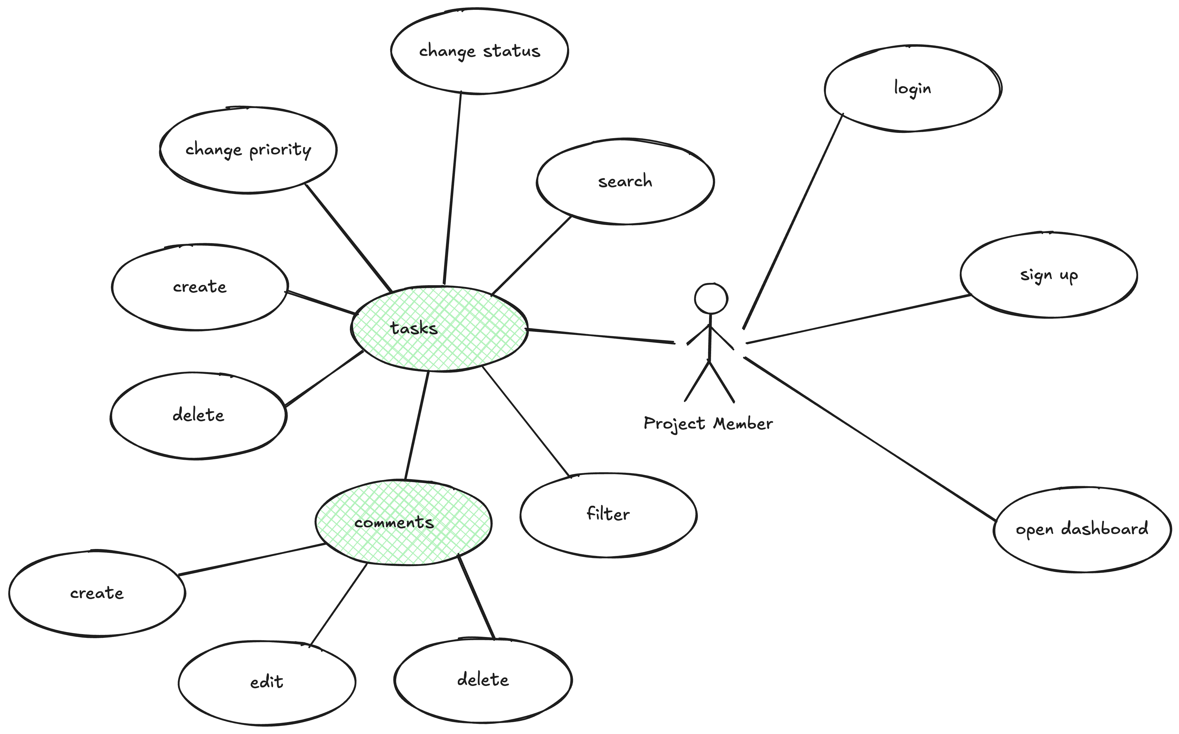
Use Case – Project Member

Slide 8
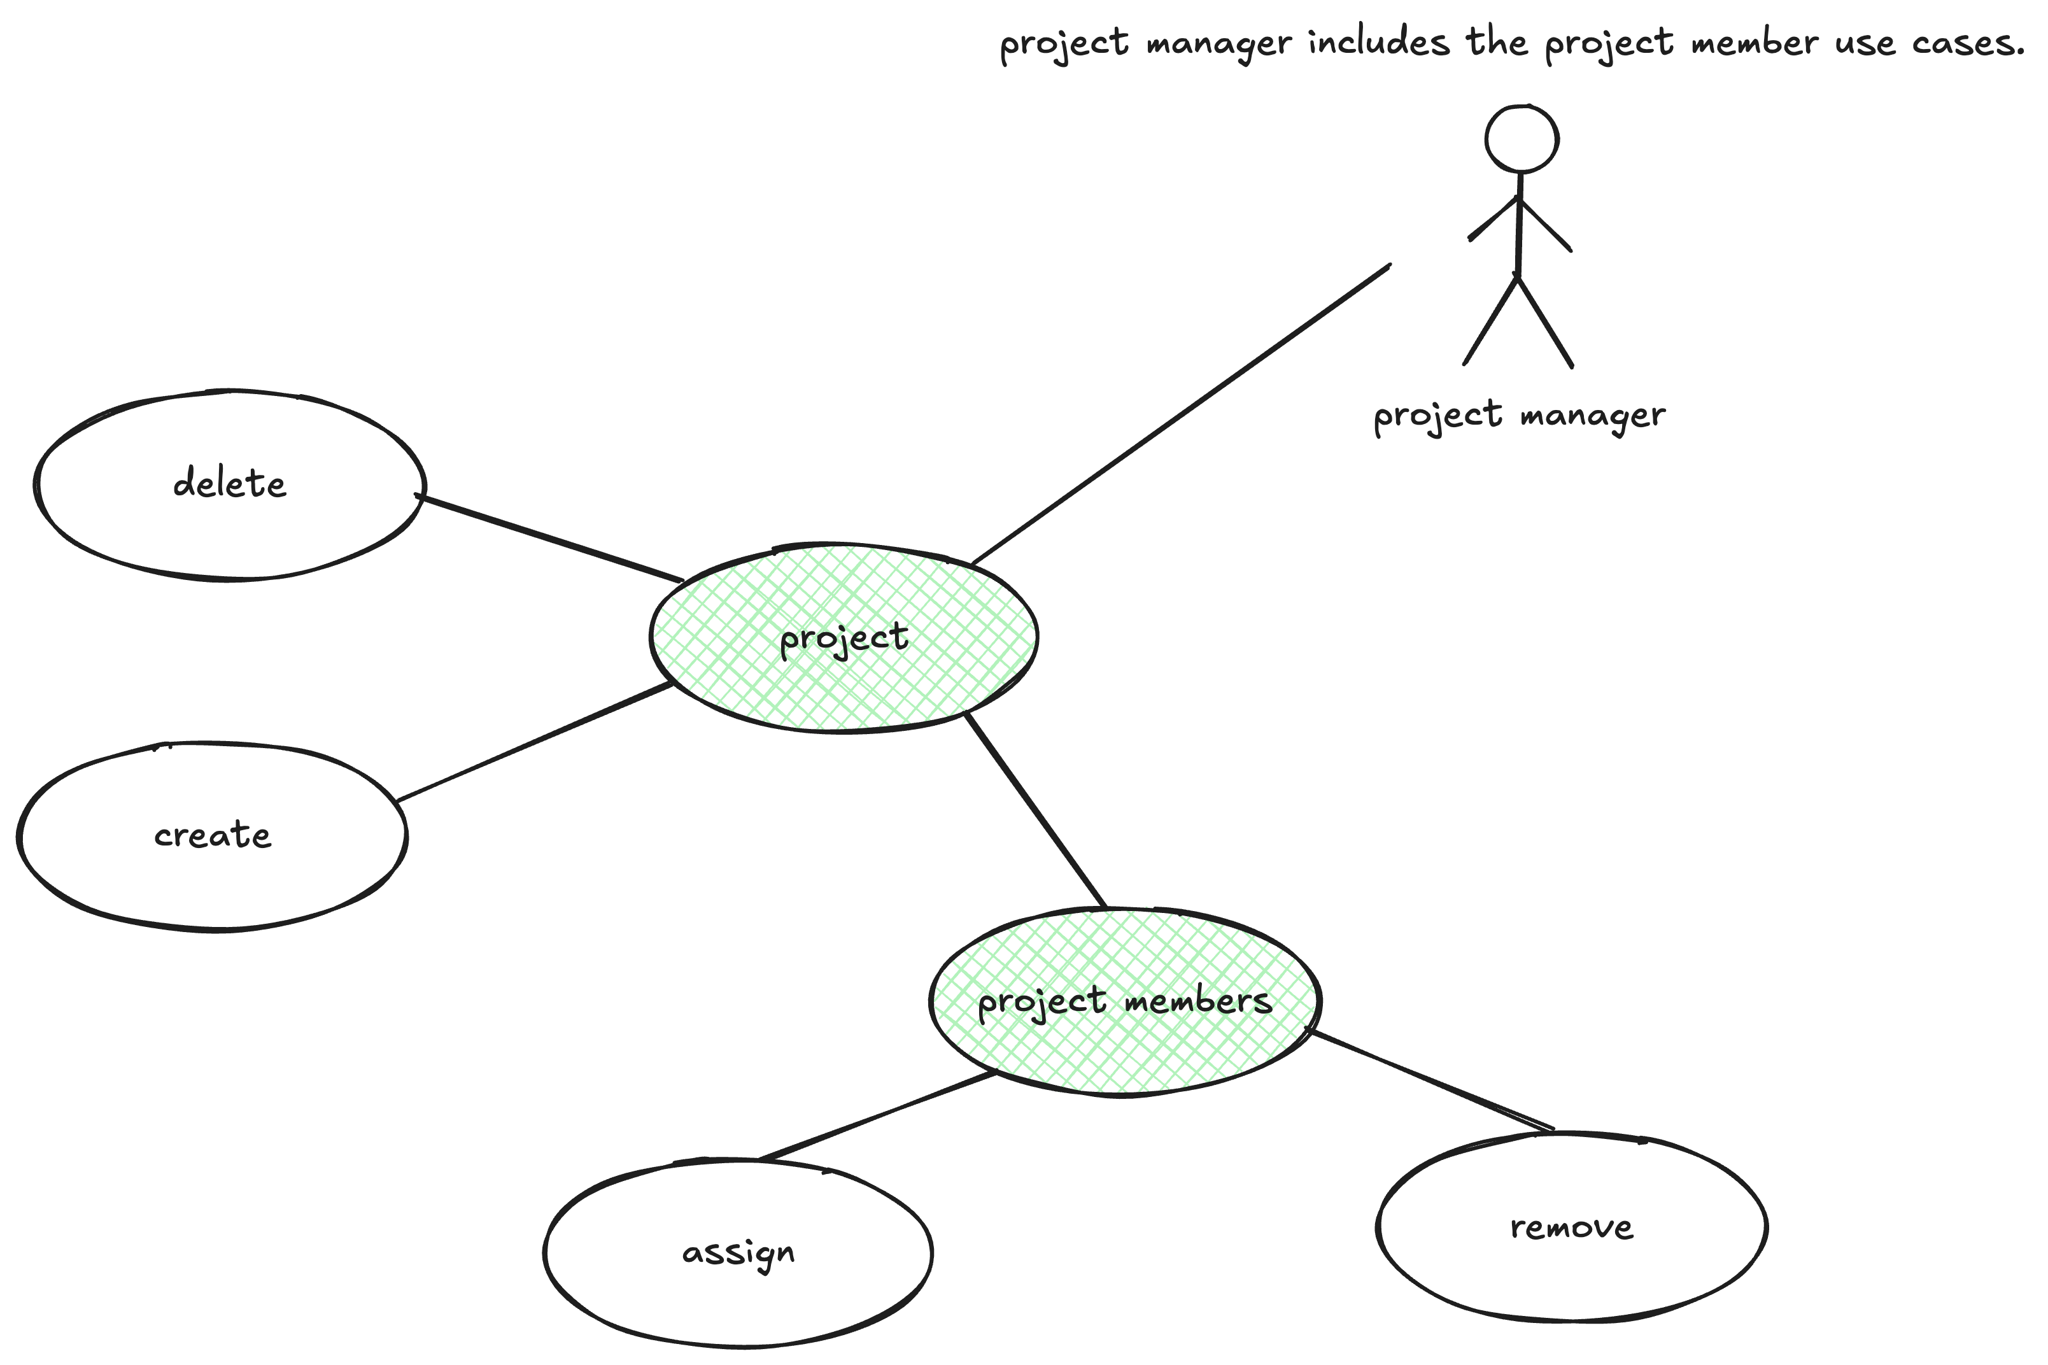
Use Case – Project Manager

Slide 9
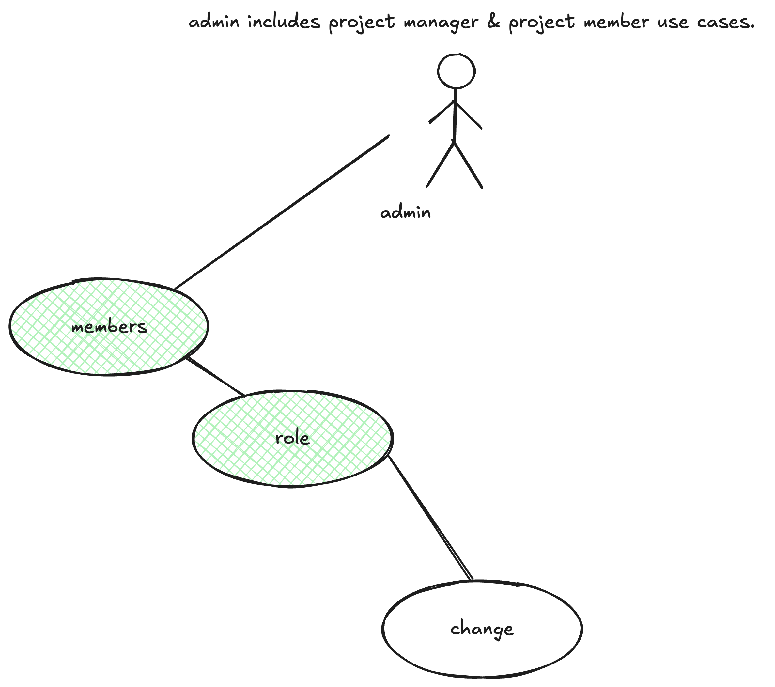
Use Case – Project Manager

Slide 10
Core Feature Ideas (Must Haves)
Task management (create, edit , delete)
Task Assignment to users
Status & priority updates
Labels / Epics for organization
Search & filtering
Project dashboard (backlog view)
User authentication (login & signup)

Slide 11
Search & Filtering
Filter tasks by:
Assigned user
Priority
Status
Keyword-based search
Improves productivity & navigation

Slide 12
Project Dashboard
Backlog-style overview
Visual task grouping
Track progress in real-time
Helps managers monitor workload

Slide 13

Authentication
Secure login & signup
User session management
Role-based access control
Protects project data

Slide 14
Nice-to-Have Features
SLA tracking for deadlines
Task escalation system
Email notifications ( on task creations / updates )
Mini Calende view
Activity history ( audit log)
Real-time chat
AI-Chatbot assistant

Slide 15
Summary
Covers essentail project management needs
Scalable and modular desgin
Supports multiple user roles

